Slide 1
3D Slicer Overview
Csaba Pinter

Slide 2

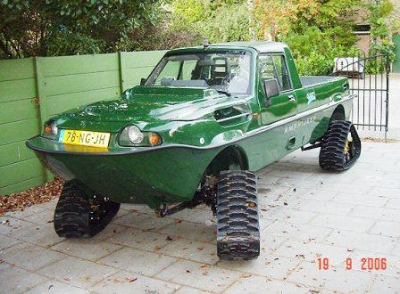
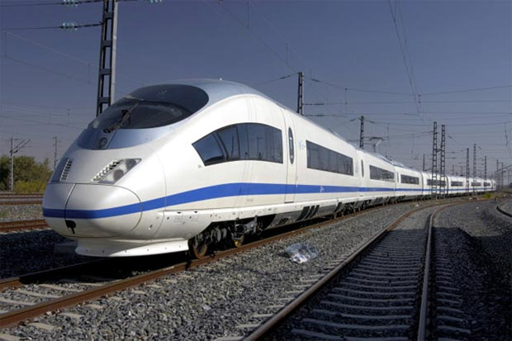
Right tool for the job
Technological prototype
Research tool
Clinical tool
Can it be done?
Innovative, not robust, usually single developer supported
Should it be done?
Robust and usable enough for clinical evaluation, flexible, open, portable, community supported
Patient ready
FDA approved, company supported, closed source
Jalopnik.com
www.unusuallocomotion.com
www.senkox.com
Notes:
The steps, from a technological prototype, to a tool, ready for the clinic, often passes through the following thought process:
1. For the technological prototype you ask yourself: Can it be done? -> Innovative, not robust, usually single developer
2. In the second stage, when your protoype will be used in biomedical research: Should it be done? -> Usability, robustness, portability and openness
3. Finally, at the clincial stage, when your intial prototype has passed through the research stage. -> FDA approved, supported, closed source

Slide 3


Without an application platform
Building on an application platform
Each application is developed from ground up
Completely new software is developed for each problem/procedure/device
Significant work is needed to integrate new, advanced algorithms
Core functionalities are already implemented
New software modules can be developed for specific needs
Many new, advanced algorithms are available
Well-supported with a large user and developer community
Quick start.
Huge waste of time, money, and effort overall.
Investment at the beginning: learning.
Minimal wasted efforts.
Notes:
Because, without an application platform
Show animations
On the other hand, if you are building your work on a pre-existing application platform
1. Portable (Win, Linux, Mac), Open-source

Slide 4
PerkLab systems overview
Slicelets
(custom Slicer applets)
LumpNav
...
ProstateNav
Gel dosimetry
...
Film dosimetry
SlicerIGT
Breach warning
SlicerRT
External Beam Planning
Slicer extensions
...
Pivot calibration
Model registration
...
Tool watchdog
DICOM-RT
Dose volume histogram
...
Dose comparison
3D Slicer
Visualization
Registration
Segmentation
...
Quantification
VTK, ITK, CTK, QT, DCMTK, …
OpenIGTLink
DICOM
PLUS
OpenIGTLink
Calibration, synchronization, pre-processing, simulation, record&replay
Device interface
software
hardware
Surgical microscopes, endoscopes
Ultrasound
scanners
Navigation
systems
Robotic devices, manipulators
MRI, CT, PET scanners
hundreds of devices (imaging, position tracking, various sensors, and manipulators)
Notes:
Using OpenIGTLink (which is a Network Interface for Image-Guided Therapy), PLUS can stream this data in real-time to 3D Slicer and can also be used for pre-processing, and calibration for navigated image-guided interventions.

Slide 5
Building on a platform
Notes:
Using OpenIGTLink (which is a Network Interface for Image-Guided Therapy), PLUS can stream this data in real-time to 3D Slicer and can also be used for pre-processing, and calibration for navigated image-guided interventions.

Slide 6
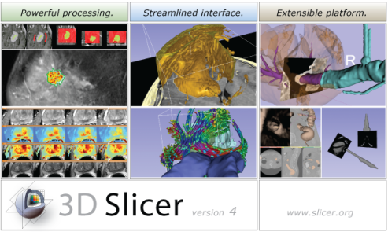



Background for 3D Slicer
Software application for medical image computing: data import/export, visualization, segmentation, registration, quantification, real-time guidance
Application framework: customizable, extensible custom modules
Completely free (BSD)
Multi-platform
User and developer support
Training courses, documentation, tutorials
Fedorov, et al. "3D Slicer as an image computing platform for the Quantitative Imaging Network." Magnetic resonance imaging 30.9 (2012): 1323-1341.
Notes:
Valley of death: Slicer does not fit traditional science funding mechanisms:
Science agencies: its not innovative
Companies: no proven clinical utility, too risky

Slide 7
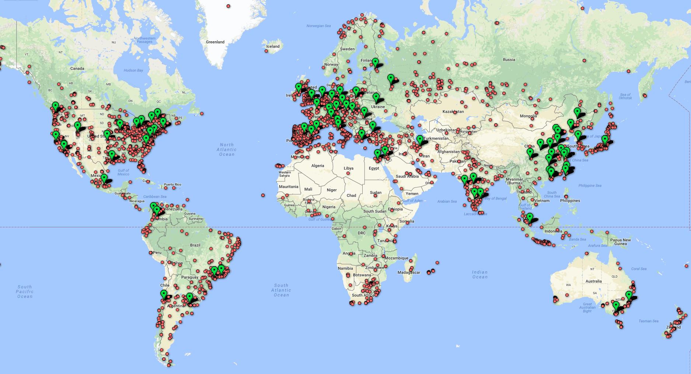
Large user community
500 downloads per week in 2012
2800 downloads per week in 2018
330 000+ downloads over the past 5 years:
Notes:
And as you can see, Slicer has a similarly sized user base here in Europe as in North-America.

Slide 8

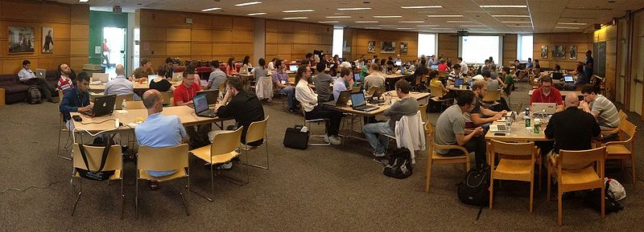
Project week
Twice a year
Bring your own project, work with experts
Meetings, training
Upcoming: June 26-30, Catanzaro Lido, Italy
Notes:
And as you can see, Slicer has a similarly sized user base here in Europe as in North-America.

Slide 9
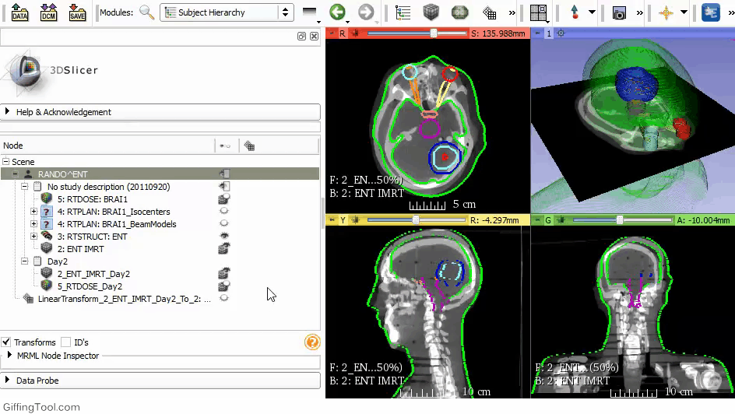
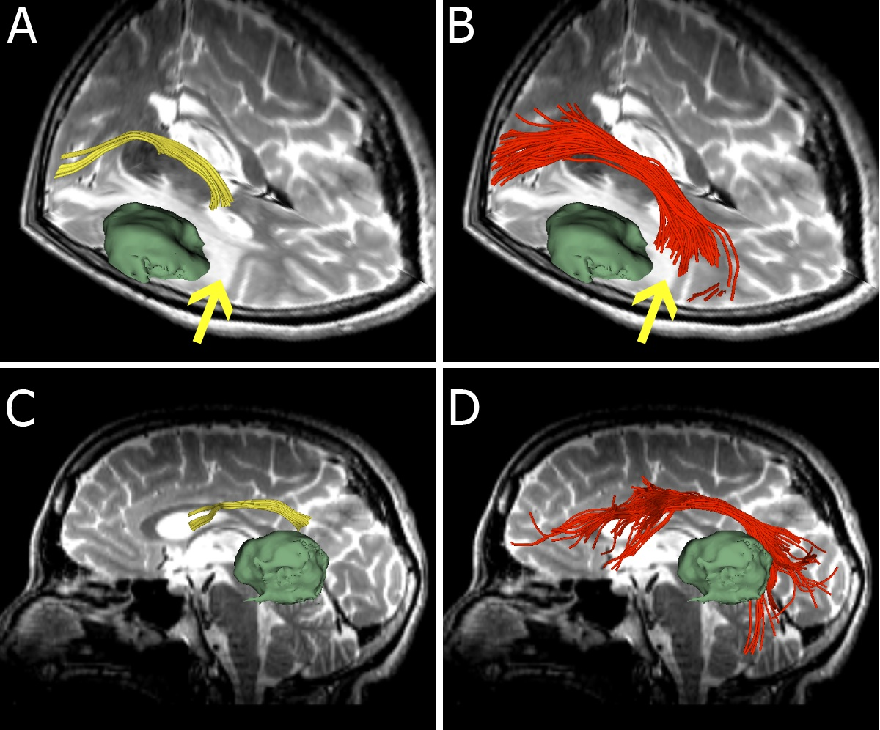
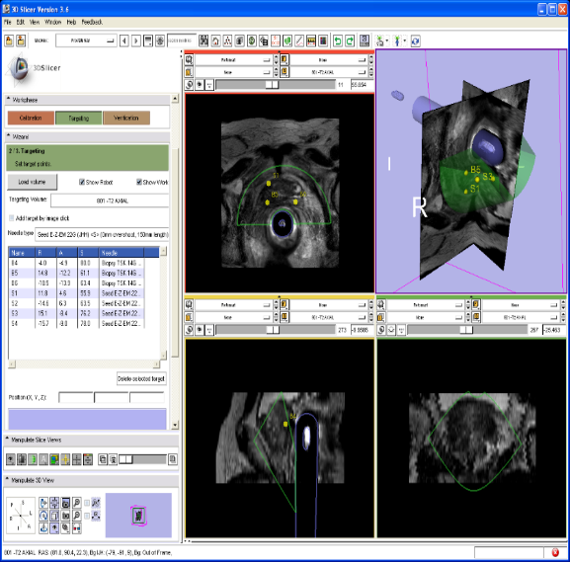
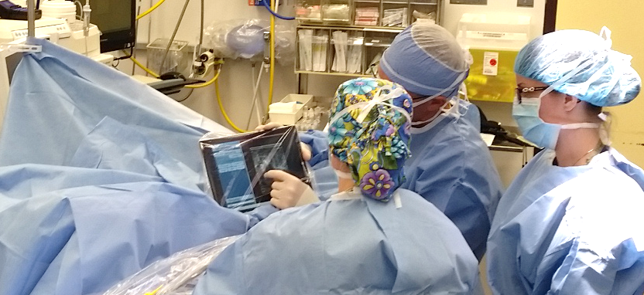
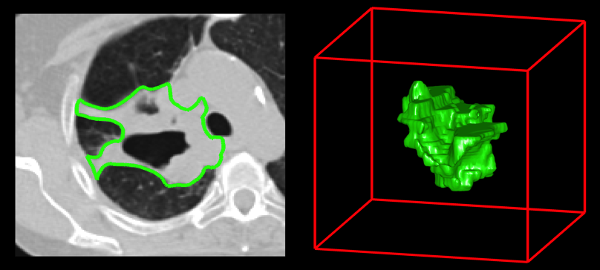
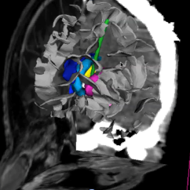
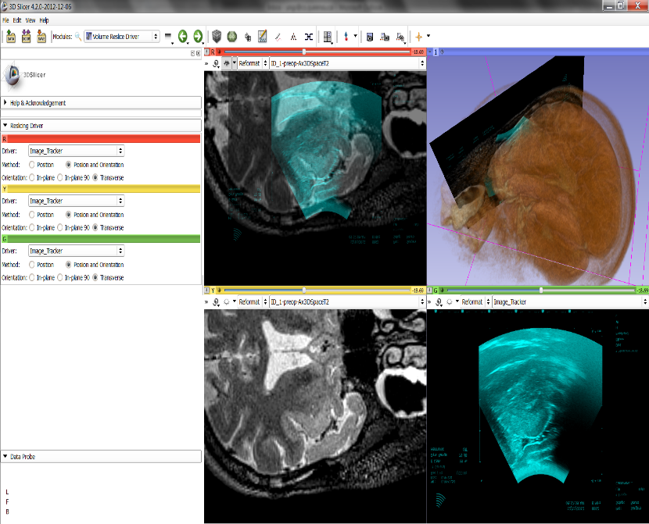
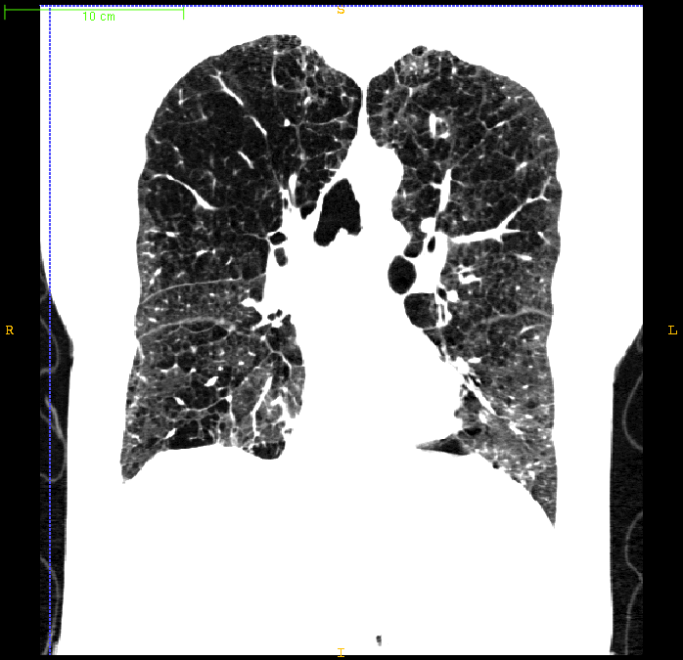
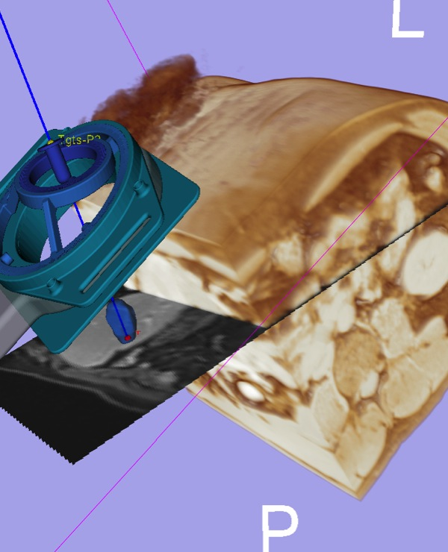
3D Slicer in clinical use
Radiation dose calculations
MRI-guided prostate biopsy
Tracking peritumoral white matter fibers
Breast cancer surgery guidance
Diagnosis of Different Tumors in Lung Cancer
Clinical users drive creation of technology
Diagnosis of Osteoarthritis Degeneration
Model-Guided Deep Brain Simulation
Quantitative assessment of COPD
Brain surgery
Surgical navigation
Notes:
Thanks to 3D Slicer clinical users can drive creation of technology (including the mandatory engineer in the clinic, obviously :). And Slicer is used in a large number of research projects.
MRI-guided prostate biopsy
-Used on 60+ patients at 3 clinical sites (Harvard Brigham and Women’s Hospital, Johns Hopkins Hospital, NIH National Cancer Institute).
-MR imaging, Custom needle positioning device, 3D Slicer with ProstateNav module
Brain surgery
-Real-time data from BrainLab navigation system and Zeiss Pentero stereo surgical microscope
-Tracked microscope video feeds recorded and visualized in real-time in 3D Slicer
-Tracked US through the dura after opening the cranium, overlay of MR/US shows brain shift
LumpNav
-More at the end of this presentation

Slide 10
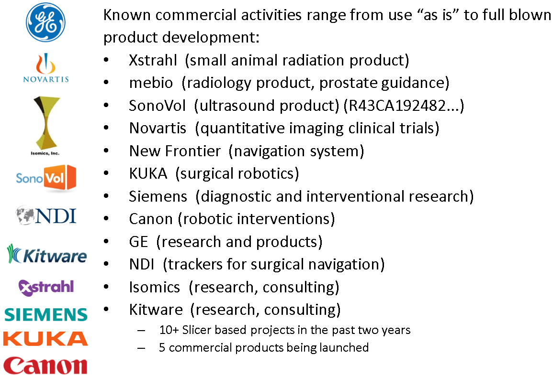
Commercial use

Slide 11
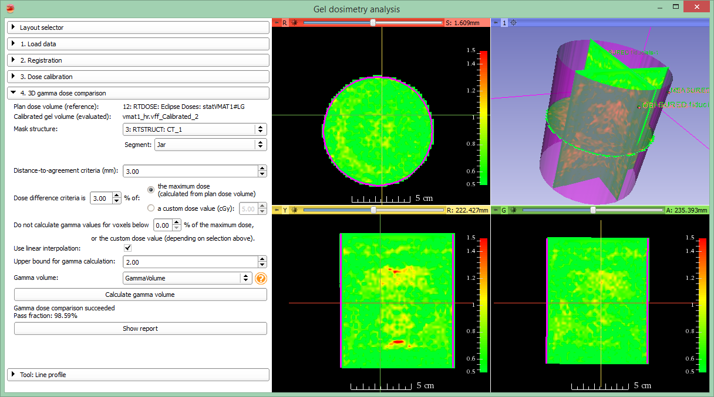
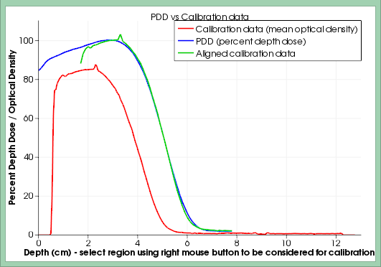
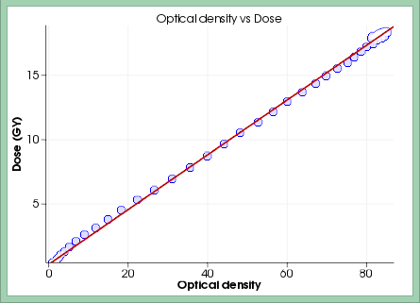
Example: Gel Dosimetry tool
https://www.slicer.org/slicerWiki/index.php/Documentation/Nightly/Modules/GelDosimetry
Chosen option: “slicelet”

Slide 12
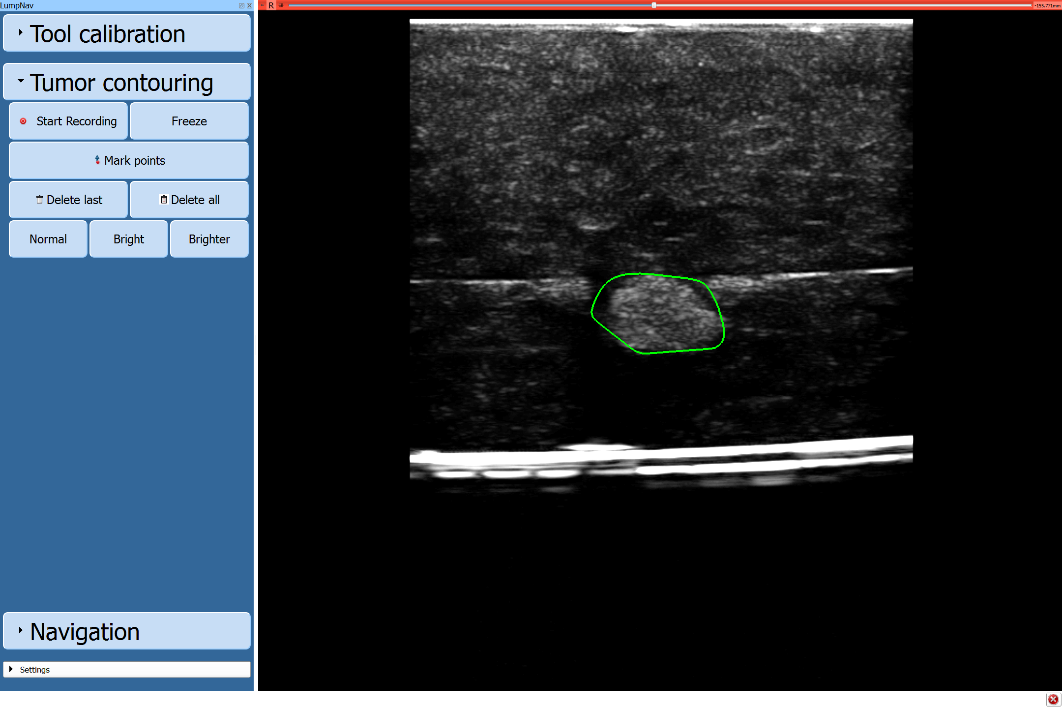
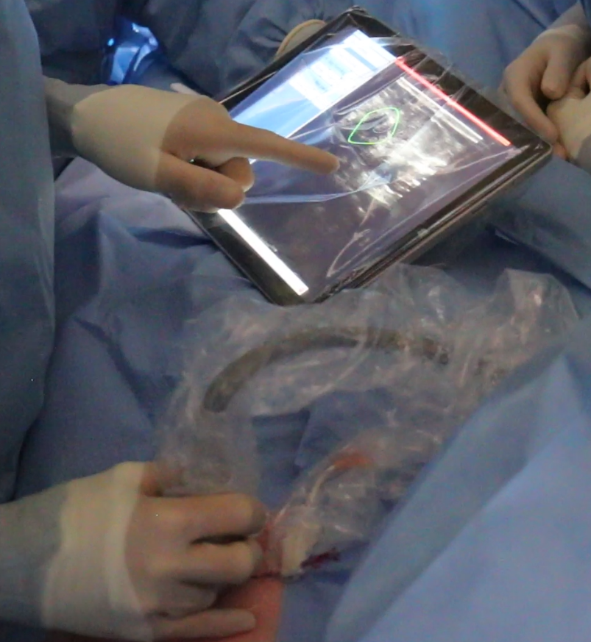
Example: LumpNav (touch optimized)
http://www.slicerigt.org/wp/breast-cancer-surgery/
Chosen option: “simplified main window”

Slide 13
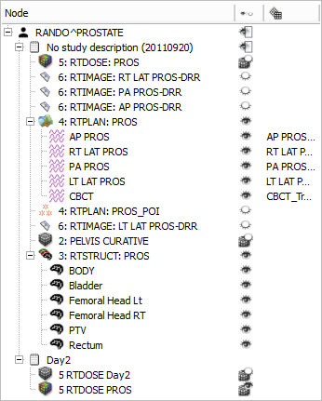
Data import/export
DICOM: 2D/3D/4D volumes, structure sets, dose volumes, etc. (extensible without Slicer core changes)
Research data formats for volumes, meshes, transforms (NRRD, MetaIO, VTK, HDF, etc.)
Common non-medical data formats (JPEG, TIFF, etc.)
Save and complete restore of application state
Notes:
Slicer supports many ways of importing and exporting data that one wants to visualize:
1. Through the DICOM (is a standard for handling, storing, printing, and transmitting information in medical imaging.) importer (which supports … )
2. Common research data formats
3. Basic data formats
Additionally, it is also possible to, at anytime, save the entire application state in order to restore the complete application state at a later time. (US ELEPHANT DEMO?)

Slide 14
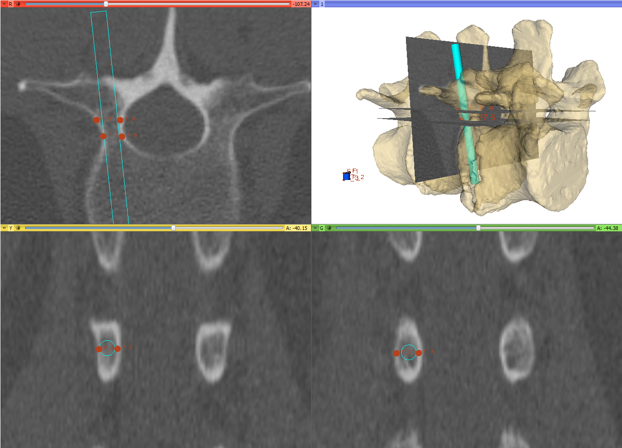
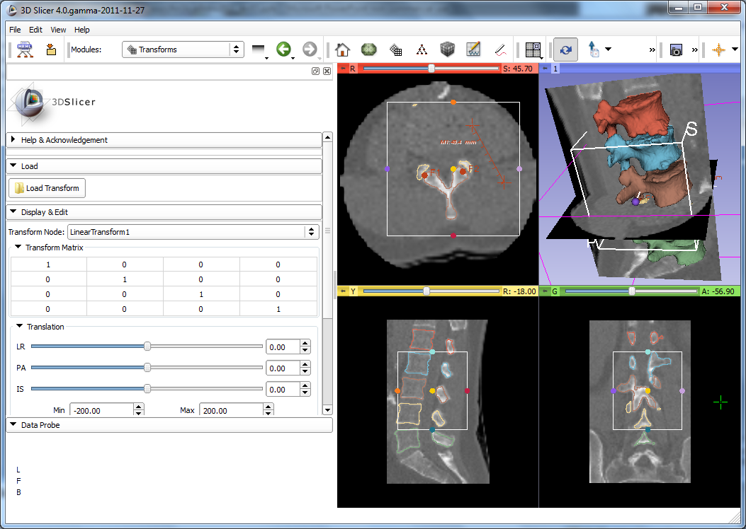
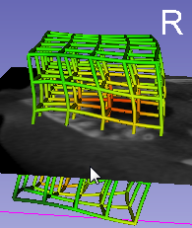
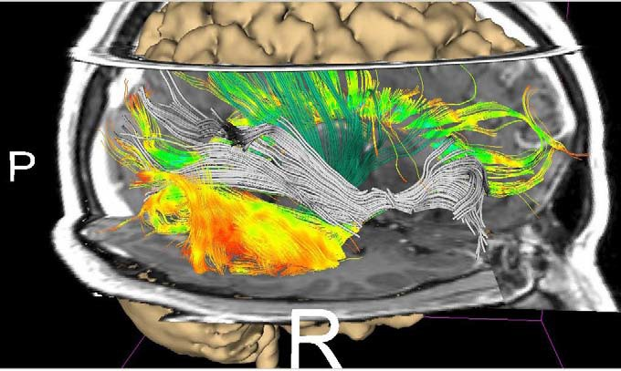
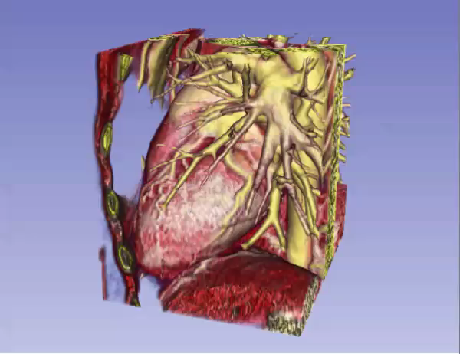
Visualization
2D (slice) and 3D views, chart views
Configurable layout
Multi-modality image fusion (foreground, background, label map)
Transforms, vector and tensor field visualization
Surface and volume rendering
Time sequence data
1
2, 3
4
5
6
Notes:
A multitude of options for visualization are available in Slicer (1,2,3,4,5,6).

Slide 15
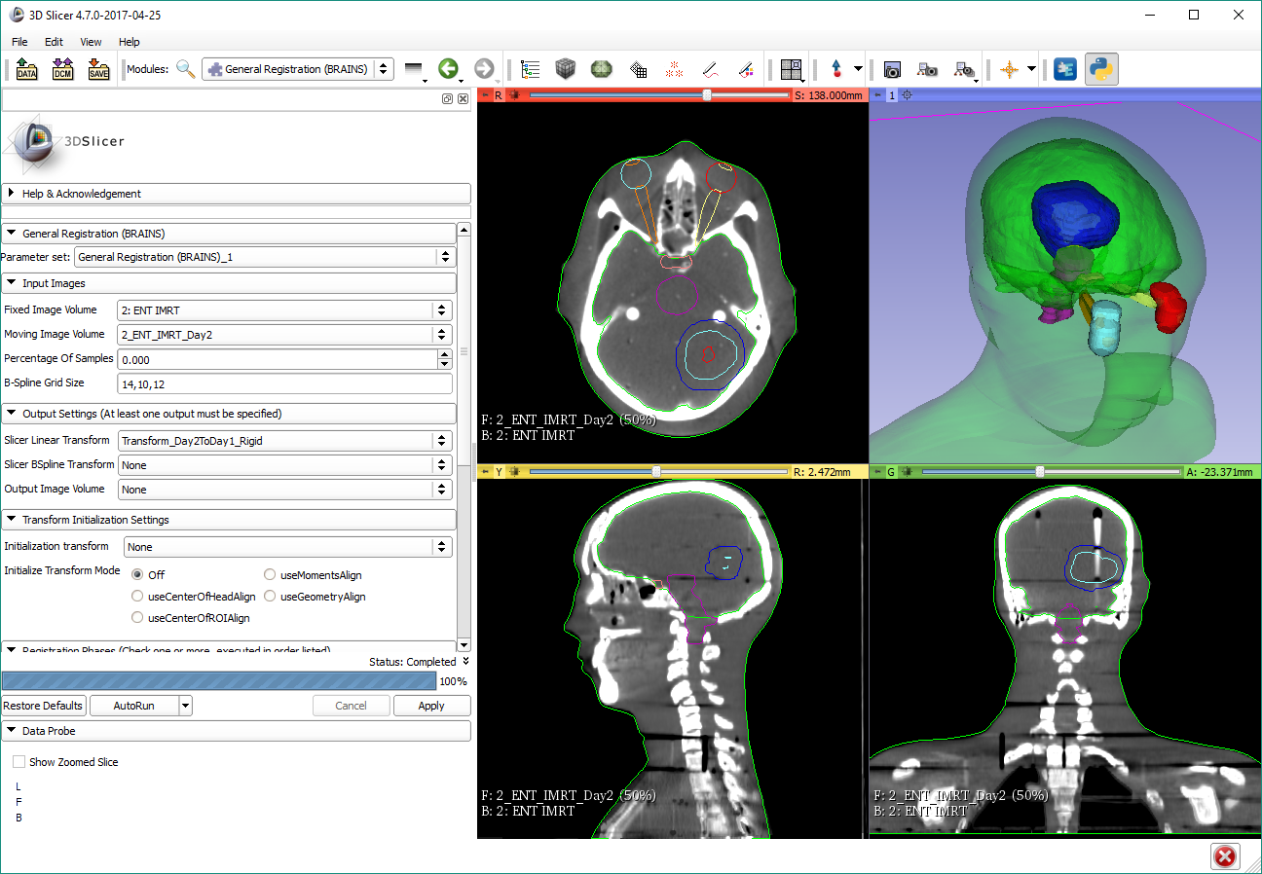
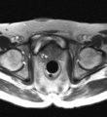
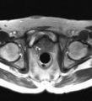
Registration
Manual: translation, rotation in 3D
Automatic: rigid, deformable, with various similarity metrics, initialization methods, optimizers, masking, etc.
Extensions: structure-based registration, Elastix, etc.
Notes:
As well as registration (which is the process of transforming different sets of data into one coordinate system, i.e. aligning images)
These are prostate MRI images, taken during MRI-guided robot-assisted prostate biopsy procedure; Slicer registers the high-resolution planning volume (acquired at the beginning of the procedure to plan biopsy targets) to the lower-resolution confirmation volume (acquired after the needle is inserted). The registration compensates for patient motion.

Slide 16
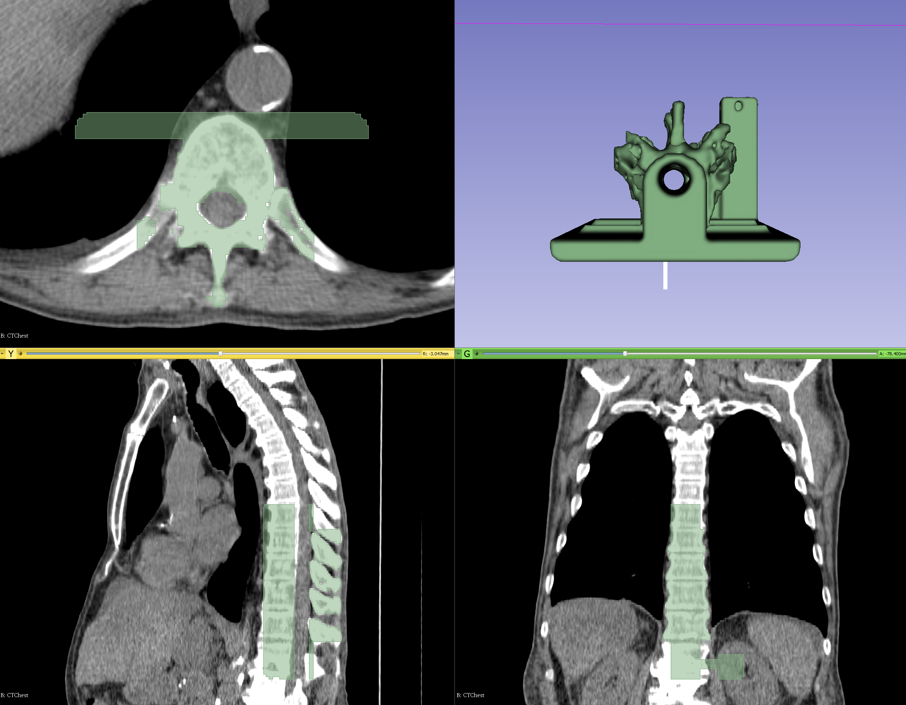
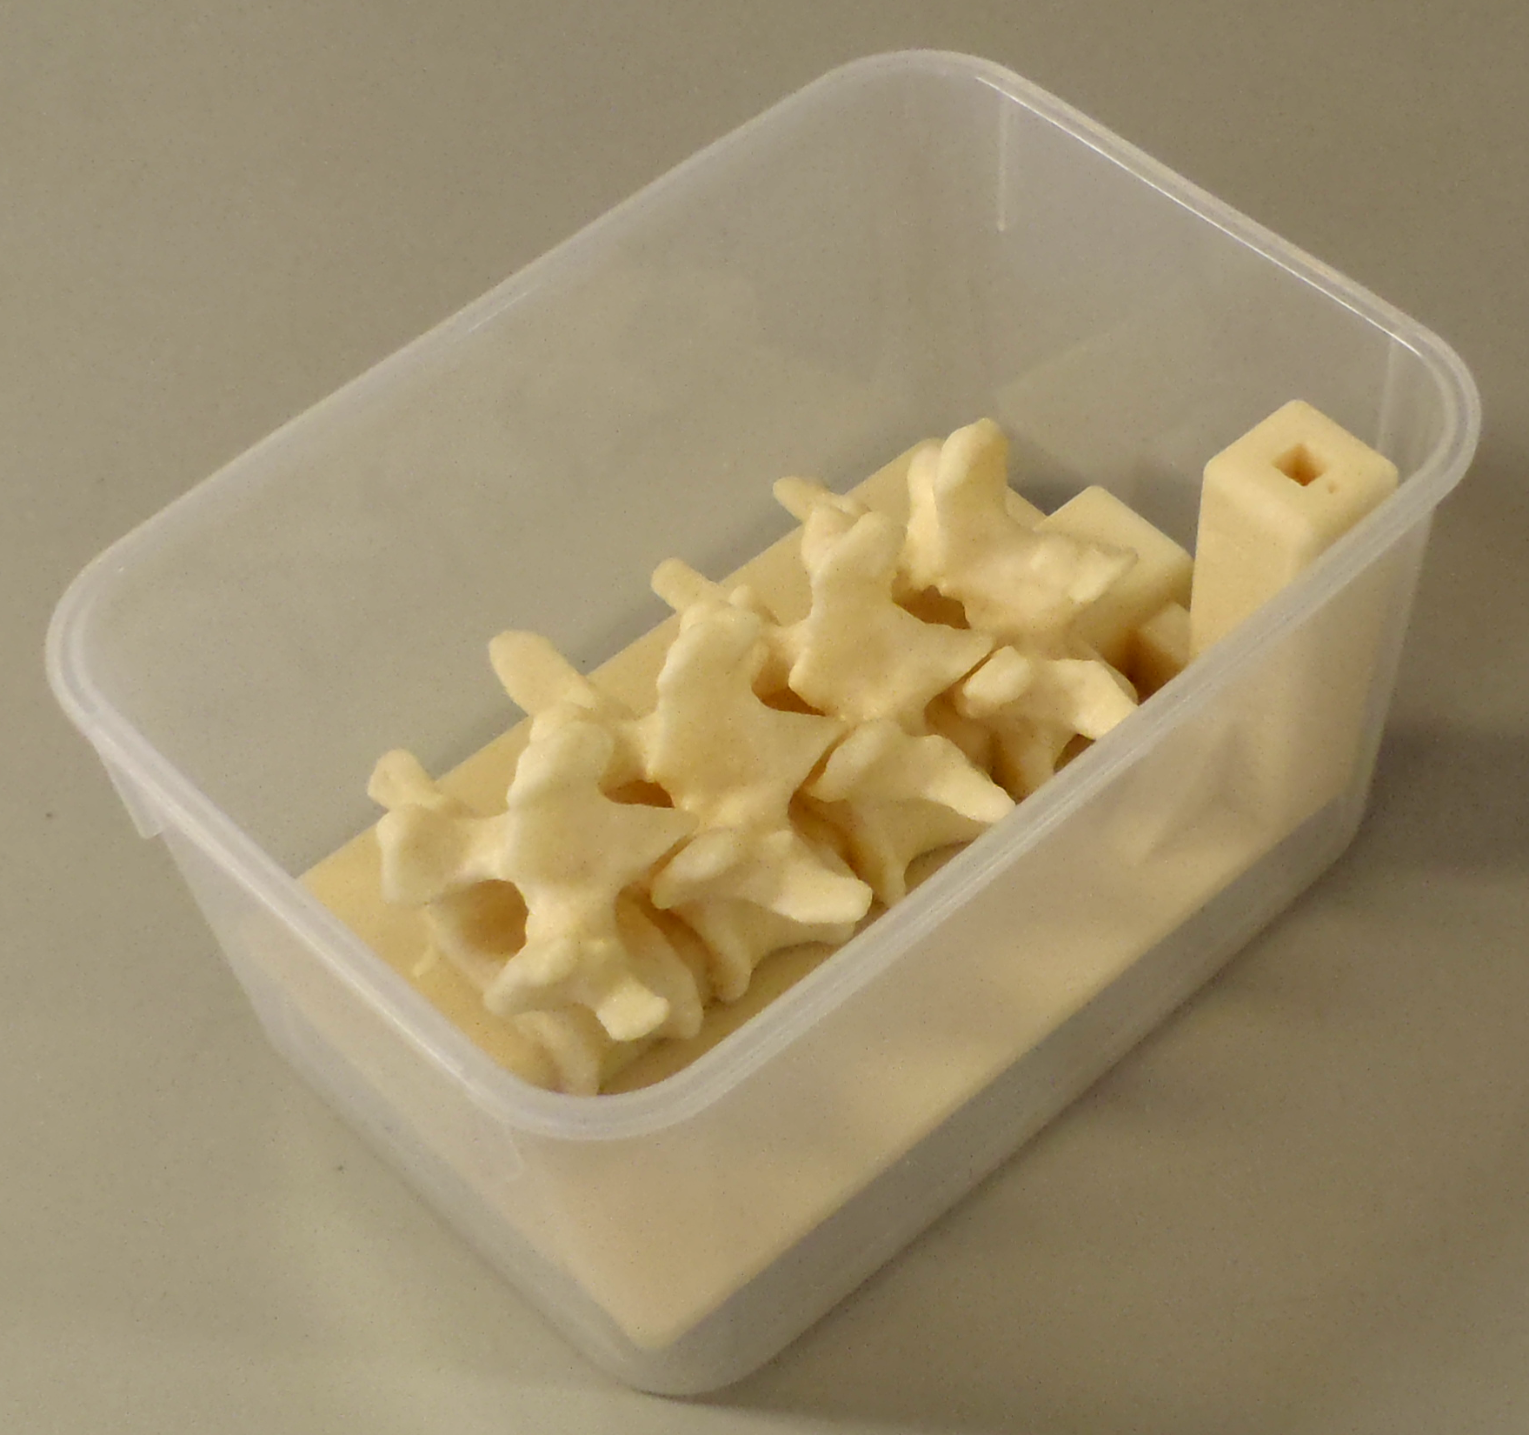
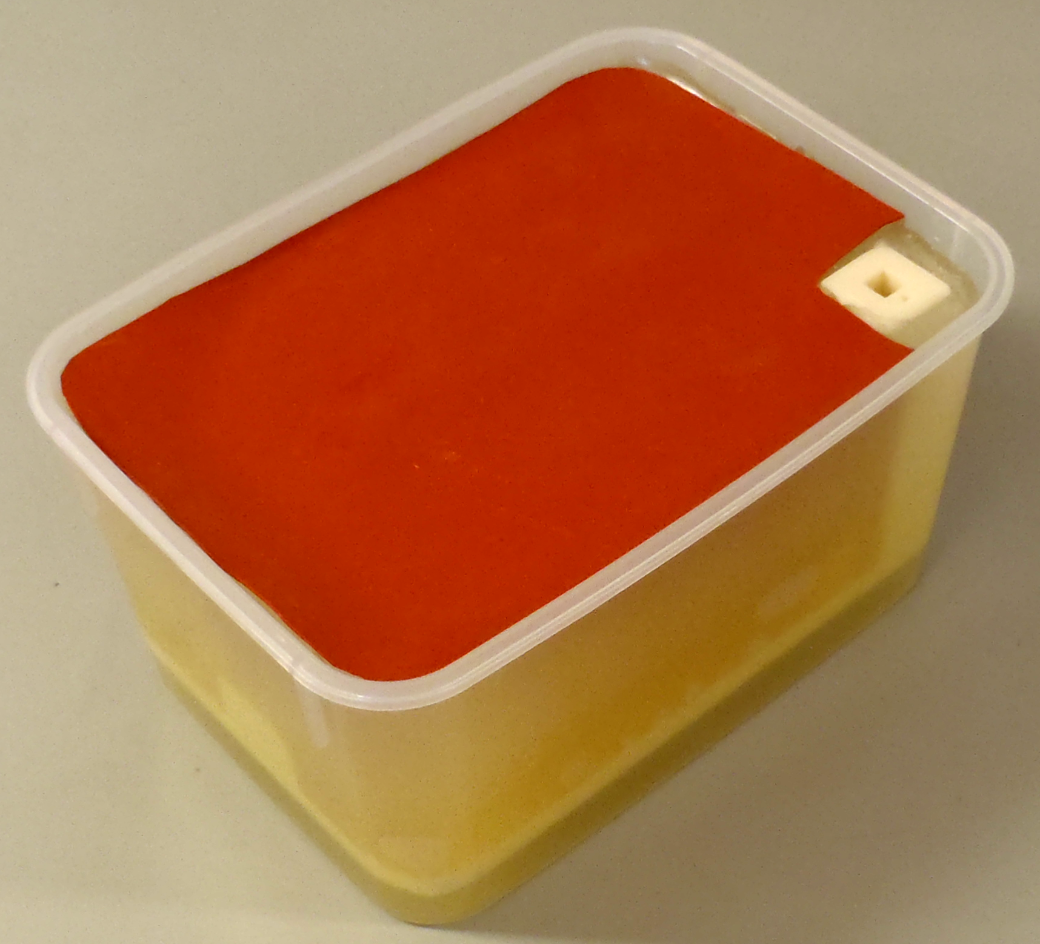
Segmentation
Manual (paint, draw, scissor, threshold, etc.)
Semi-automatic (region-growing, fill between slices, etc.)
Automatic (atlas-based, robust statistics, etc.)
Notes:
As for the common task of segmentation (which means to divide an image into multiple parts which is typically used to identify objects), Slicer supports both manual approaches (like contouring and painting) as well as automatic (like region-growing and atlas-based).
The Slicer screenshot here shows a segmented prostate in the Editor module where many of these tasks can be performed.

Slide 17
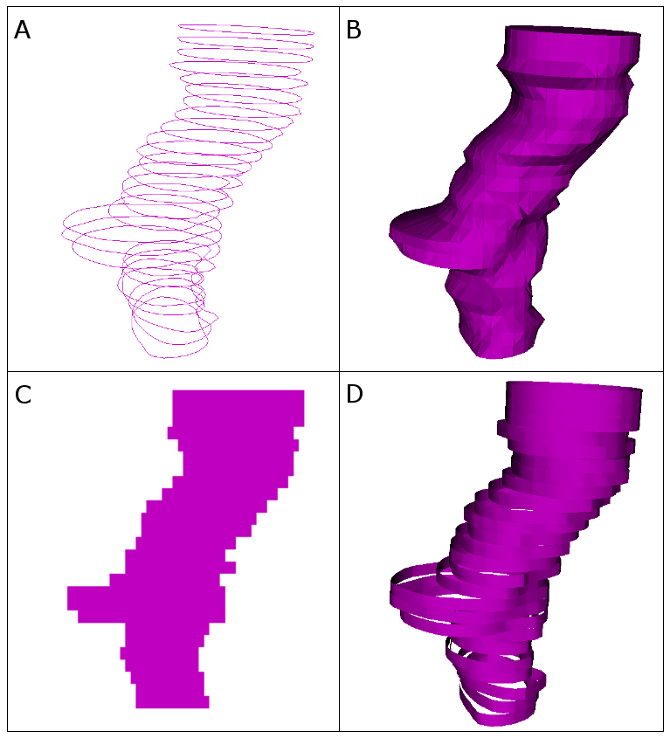
Various representations
Each optimal for
either storage (A)
or analysis (C)
or visualization (B,D)
Imposed needs
Conversion
Simultaneous
Visualization
Transformation
Typical representations: A: Contours, B: Surface, C: Image, D: Ribbons

Slide 18
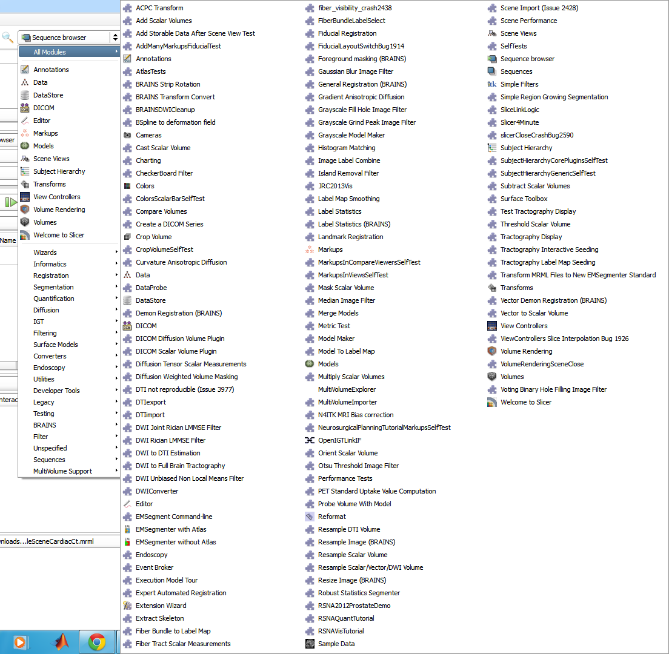
Many other modules...
Image filtering (image noise reduction, MRI bias correction, etc.)
Surface processing
Diffusion imaging
Quantification, statistics
...
Notes:
And many other modules are available by default, like for example: Informatics modules, for …; Filtering modules, for …; as well as many more.

Slide 19
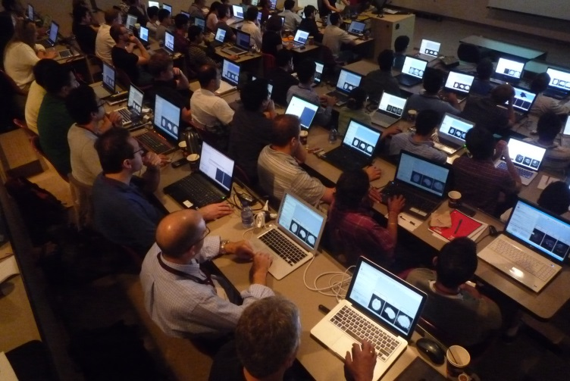
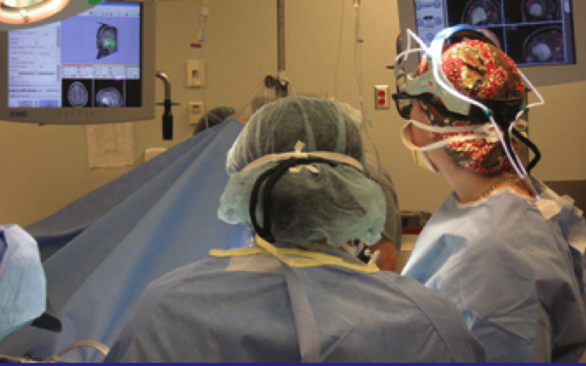
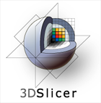
Slicer for translational research
What does a developer need ?
Easily deployable
Extensible and reconfigurable rich utility libraries
Stable base
What does a user expect ?
Easy install and upgrade
“Standard” clinical behavior
Advanced functionality
Consistent interface
3D Slicer: a cross platform system for
translating innovative algorithms into
clinical research applications
Courtesy R. Kikinis
Notes:
3D Slicer bridges the “valley of death” for subject specific analysis

Slide 20
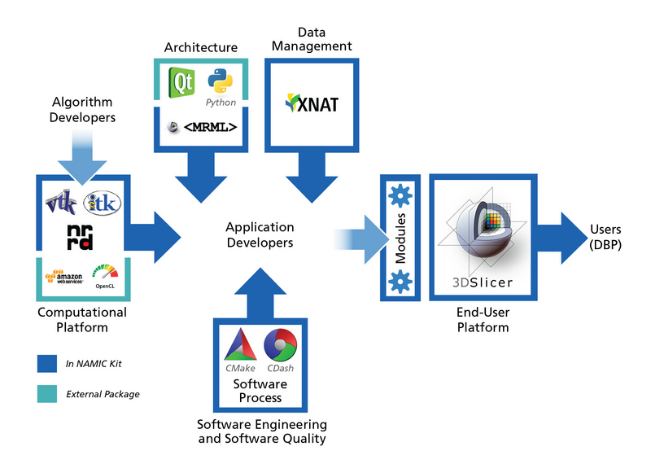
The NA-MIC kit

Slide 21
What’s inside Slicer?
Slicer core: Slicer GUI, I/O, visualization and developer interfaces
Slicer modules: internal plugins that depend on the slicer core
Slicer extensions: external plugins installed on demand by the user

Slide 22
Data handling: the MRML scene
MRML: Medical Reality Modeling Language
All objects (volumetric images, surface models, transforms, etc.) are stored in a hierarchical structure of MRML nodes
Each MRML node has its own list of custom attributes that can be used to specify additional characteristics for the data object
Enables the modules to have access to the MRML tree, allowing new extensions to leverage existing processing and visualization functions without directly interfering with other modules

Slide 23
Python in Slicer
The Python console of Slicer4 gives access to
Scene objects (MRML)
Data arrays (volumes, models)
GUI elements (Qt) that can be encapsulated in a module
Processing Libraries
numpy
VTK
ITK
CTK

Slide 24
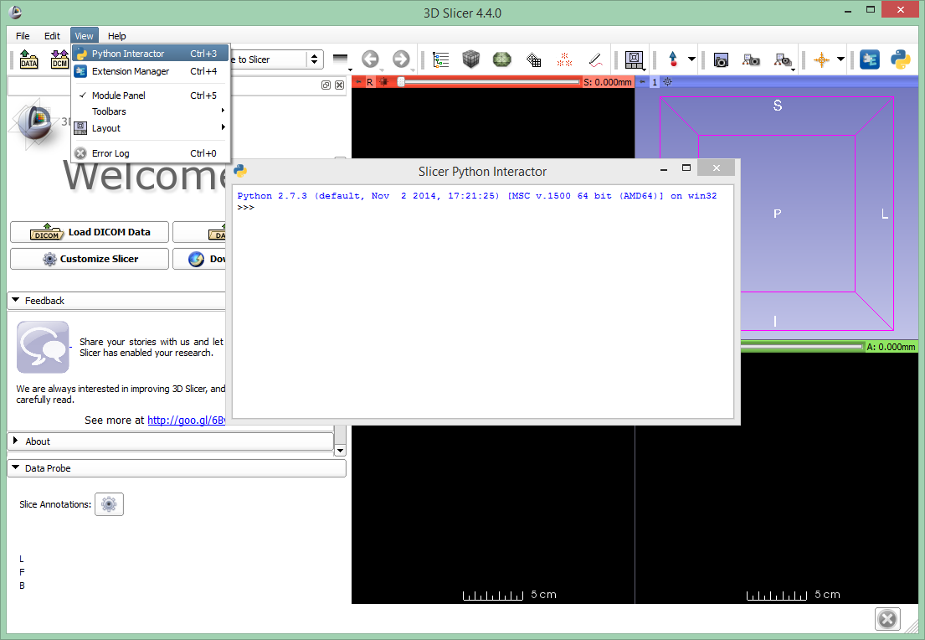

Python console in Slicer

Slide 25
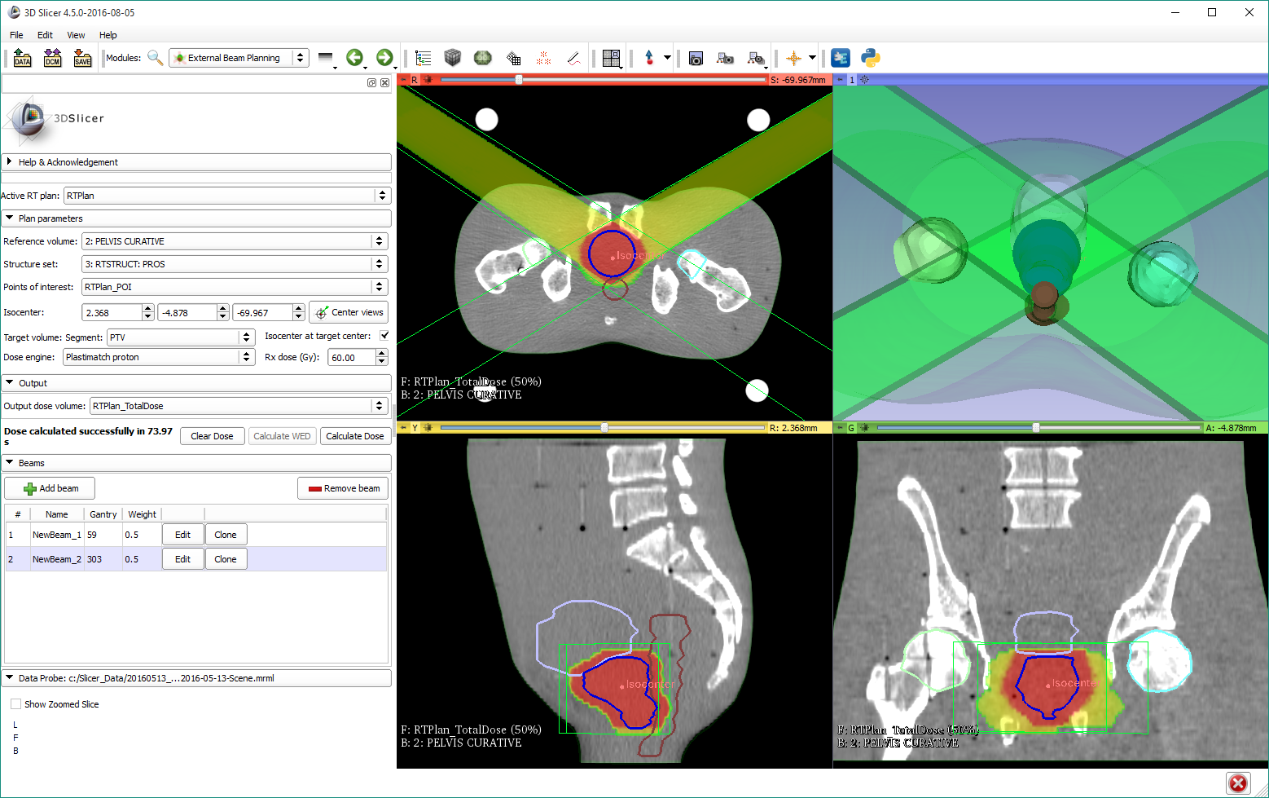
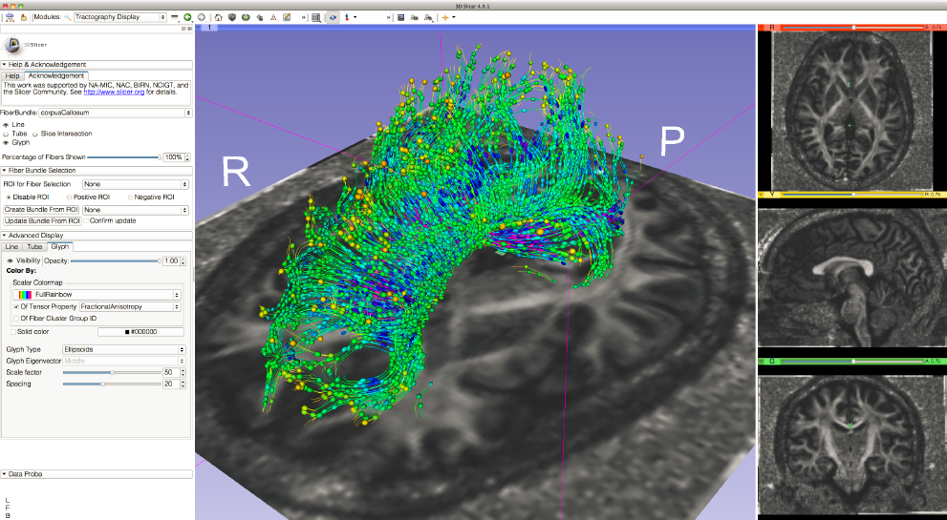
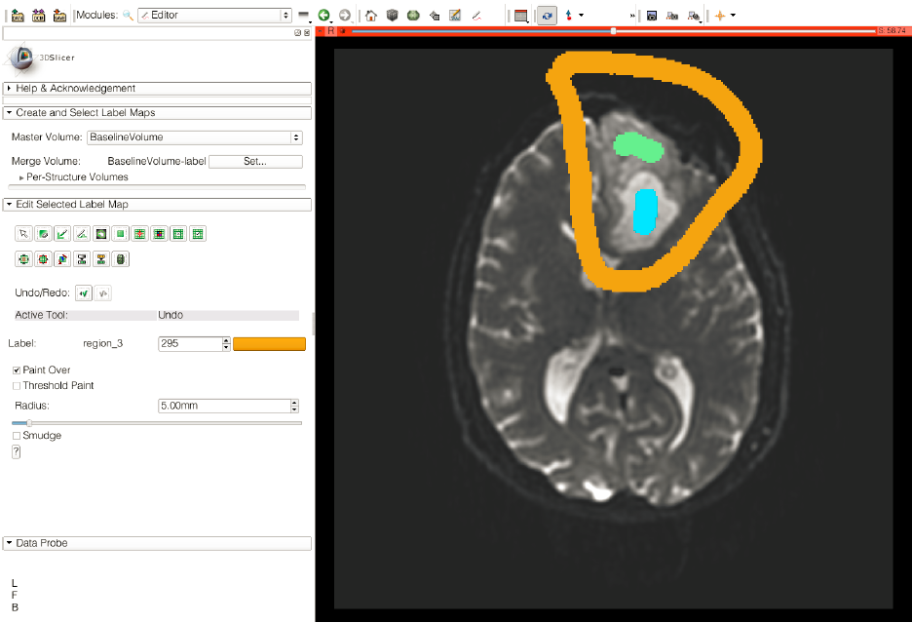
Slicer modules
Three types of modules:
Scripted modules – written in python
Command-line modules (CLI) – use ITK
Loadable (interactive) modules – written in C++
e.g. Tractography labelmap seeding
Image courtesy: Sonia Pujol
e.g. External beam planning
e.g. Editor image courtesy: Sonia Pujol

Slide 26
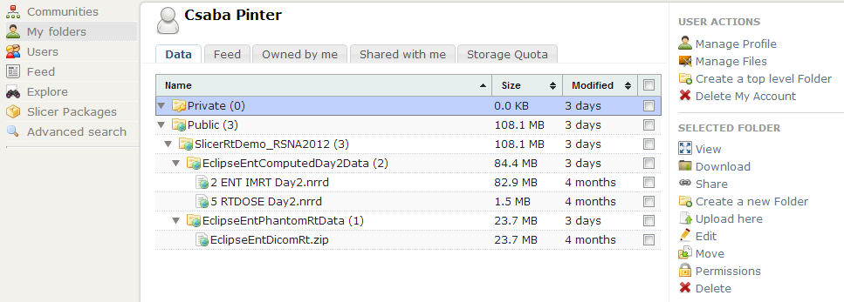
MIDAS
Platform that provides a flexible, intelligent web-based data storage system
Slicer has adopted MIDAS to store testing and algorithm validation dataset
Dedicated NA-MIC MIDAS community has been created
Slicer releases can also be downloaded from the server

Slide 27
Automatic regression testing
Automatic tests ensure detecting regression errors
Results published on web-based dashboard
Types
Qt generic tests – automatically generated
Logic tests – need to be written
Tests a custom module’s underlying logic (algorithm)
In folder CustomModule/Testing/Cxx
Python self-tests
Comprehensive test for a custom module
In folder CustomModule/Testing/Python
Details: http://wiki.slicer.org/slicerWiki/index.php/Documentation/Nightly/Developers/Tutorials/SelfTestModule

Slide 28
Share your tools
In the spirit of the open-source paradigm, it is encouraged to share your tools
The shared extensions
appear in the Extension Manager
are nightly tested on the Slicer Factory platforms
How to share?
Fork ExtensionIndex from GitHub and upload your extension description (.s4ext) file https://github.com/Slicer/ExtensionsIndex
Ask the core team to integrate (send a “pull request”)

Slide 29
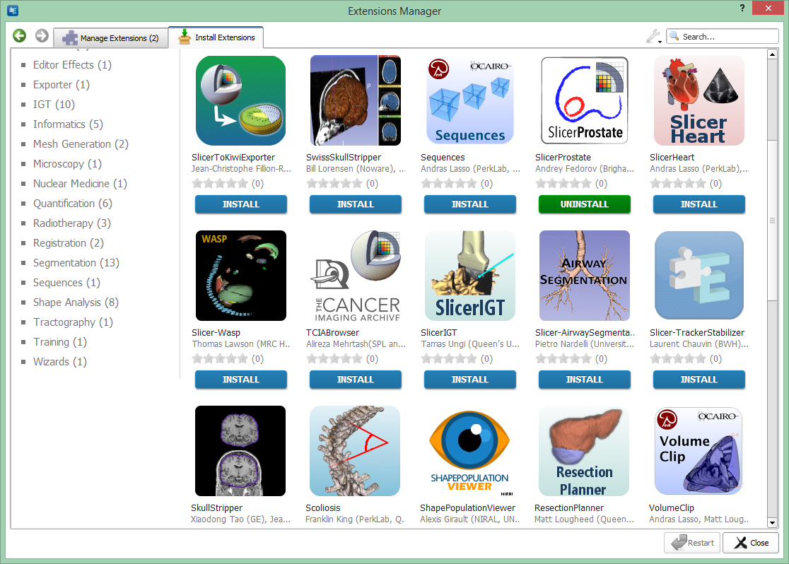
Slicer is extensible
The Slicer Extension Manager offers the possibility to the user to download and install additional Slicer modules

Slide 30
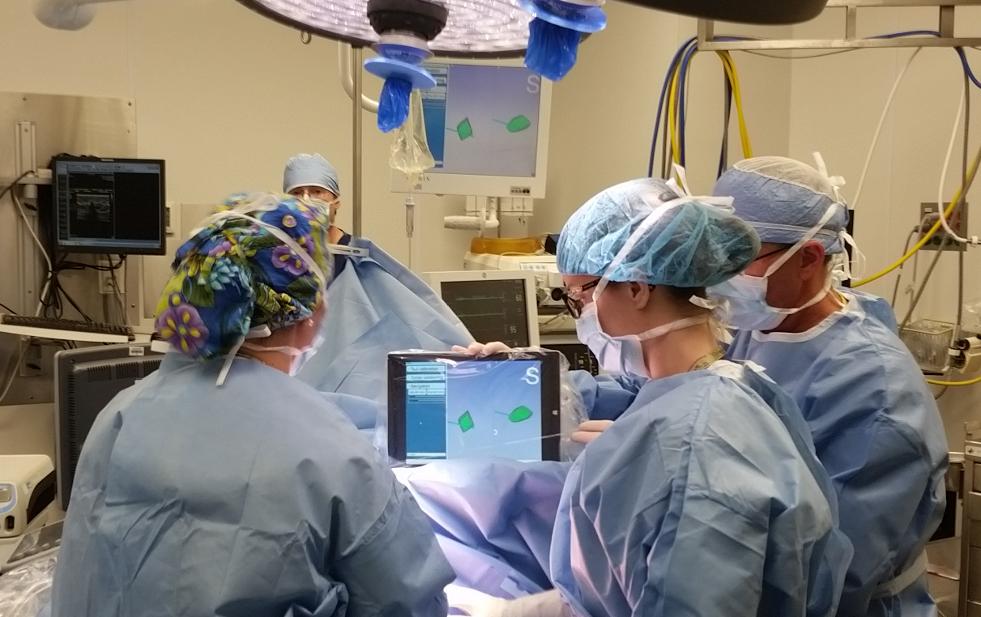
Major extension: SlicerIGT
Toolkit for image-guided therapy
Basis for navigation “guidelets”

Slide 31
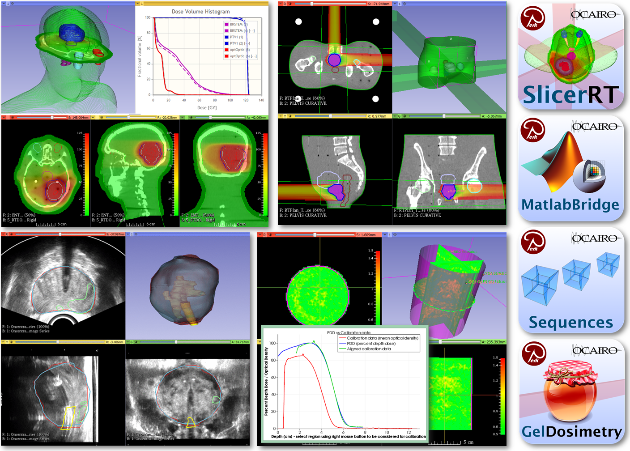
Major extension: SlicerRT
Toolkit for radiation therapy

Slide 32











Further notable extensions
PerkTutor
SegmentEditorExtraEffects
DebuggingToolsForExtensions

Slide 33
Slicer introduction tutorials
In this session, please use the nightly Slicer version you installed (4.9.0-2018-04-23)
Please note that this is a cutting edge nightly build, so if anything happens differently than you expect, please let us know
Thanks for helping us test the latest Slicer ☺
Linux users: Please use 4.8.1
Mac users: Please use 4.8.1, only for the registration section

Slide 34
Tutorial sections
Visualization
load/save, sample data, viewers, models, volume rendering (30 min)
DICOM
tags, where to get them (web, TCIA browser), loading options, plugins, export (15 min)
Segmentation
Segment Editor effects, workflows (45 min)
Registration
BRAINS, Elastix, landmark registration, SegmentRegistration, transforms, transform visualization (45 min)
Other: Sequences, MatlabBridge, Virtual reality (15 min)

Slide 35
Appendix

Slide 36
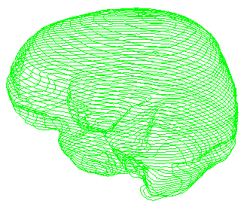



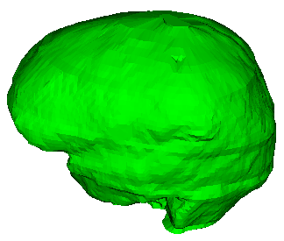

Segmentation “object”
Patient
1 segmentation contains N segments (structures)
Patient
Brain
Brain (contour)
Tumor
Tumor (contour)
Each segment contains multiple representations
Provides automatic conversions

